Slide 1


HACKATHON
ENGAGE 4.0
TEAM DIDDLERS

Slide 2

GROUP MEMBERS OF TEAM DIDDLERS
JATIN 24CSU282
TANISHQ 24CSU262
DEVANSH 24CSU277
ARYAN 24CSU285
GAURAV 24CSU333

Slide 3


Slide 4


Slide 5



Slide 6


Slide 7


Slide 8


Slide 9


Slide 10


Slide 11


Slide 12



Slide 13
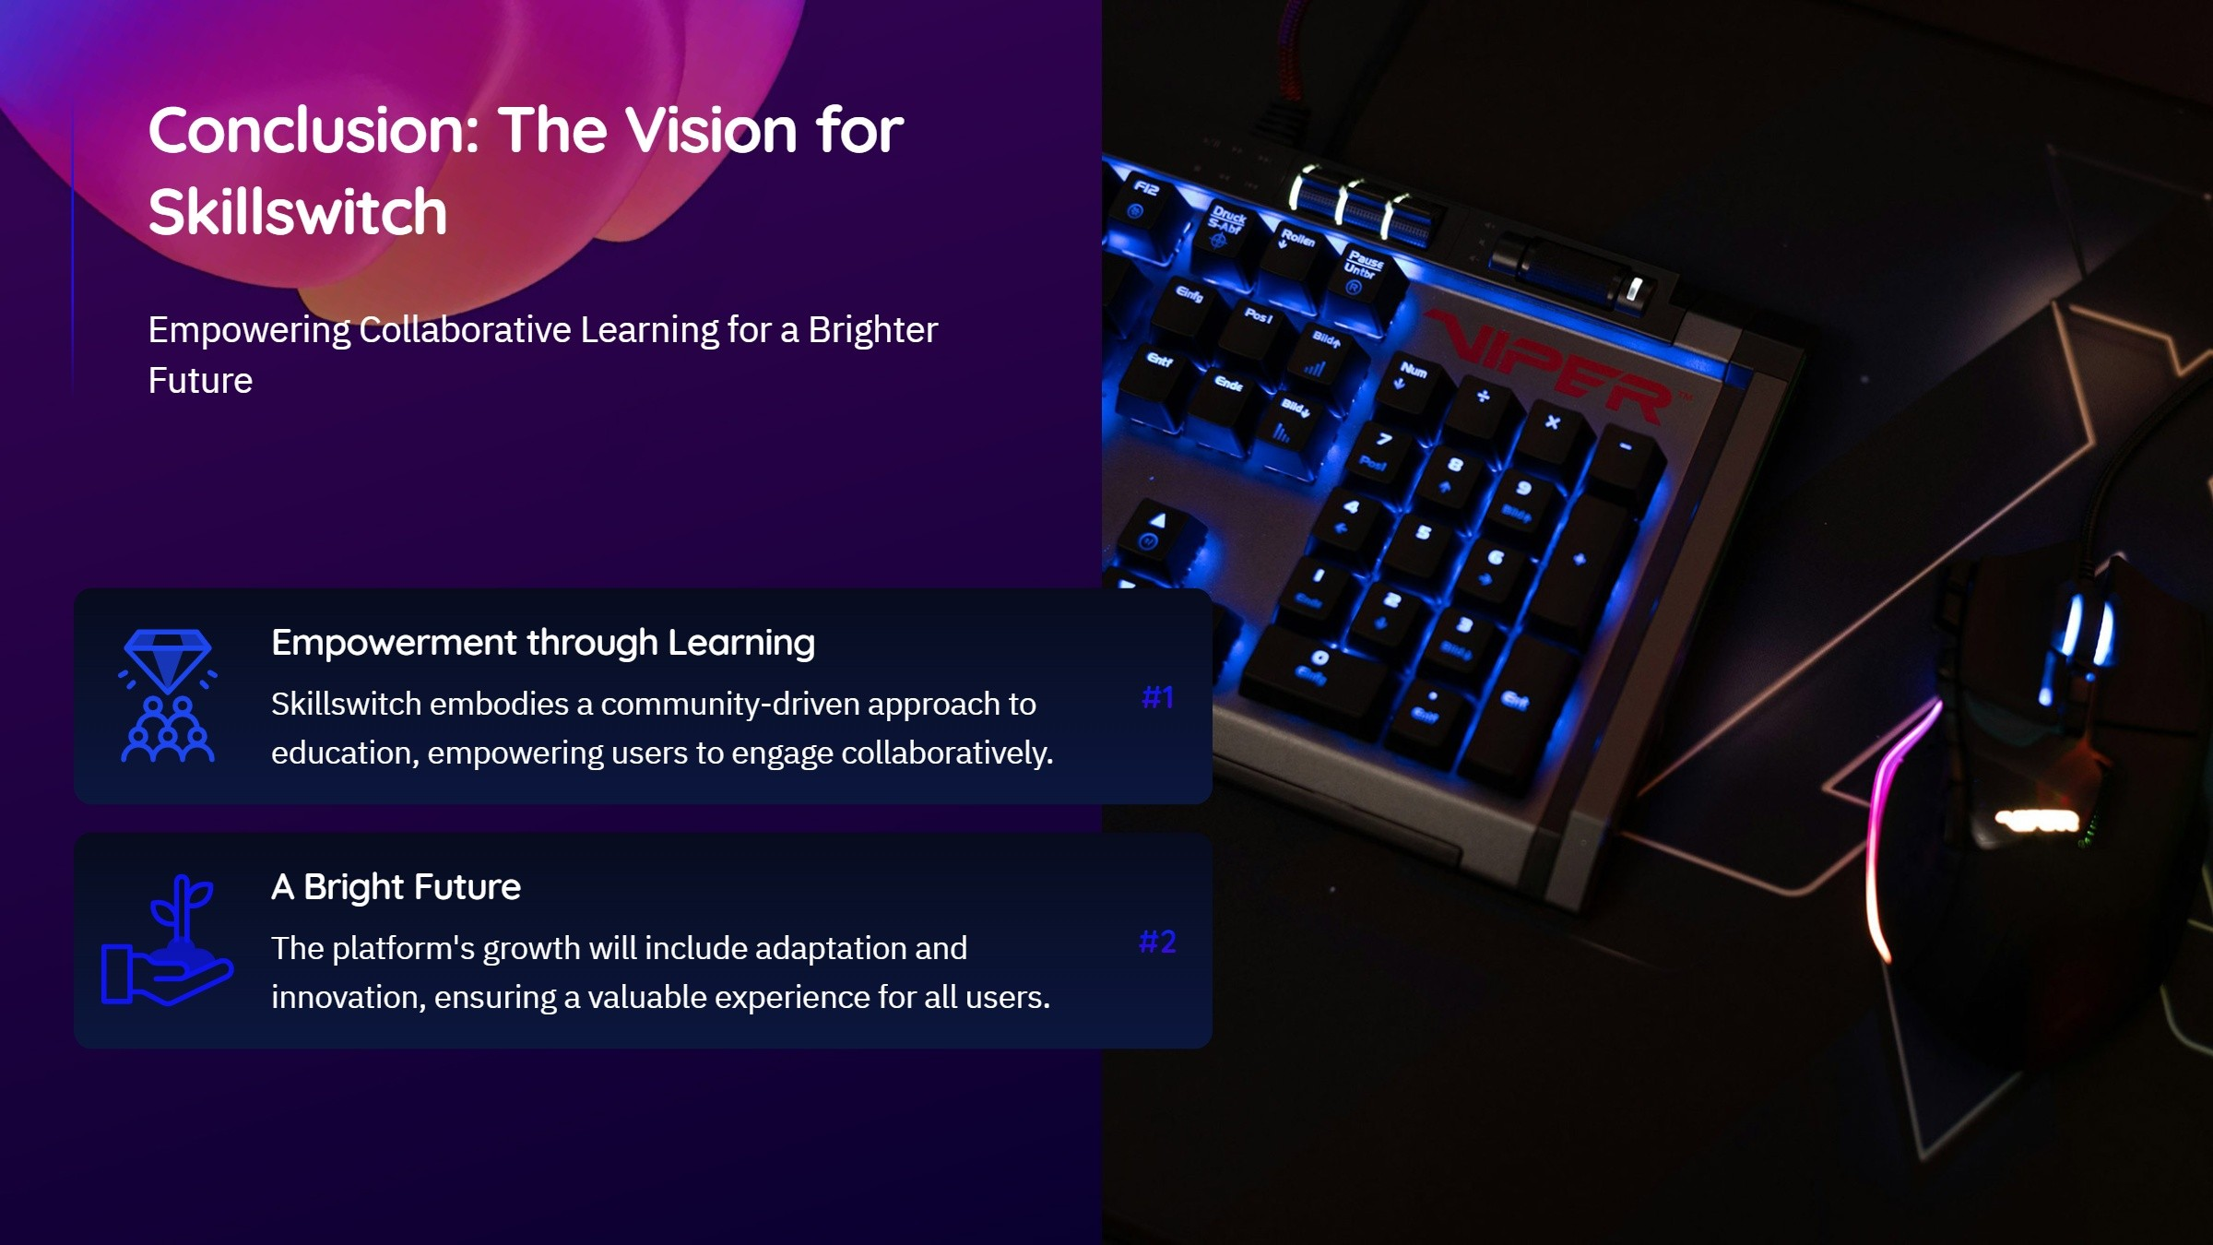

Slide 14

THANK YOU EVERYONE
SKILLSWITCH

